Slide 1
COMP2106 – Advanced Server Side Scripting

Slide 2
Getting Started
with GitHub
1
Stations Along the Way
Intro to GitHub and Version Control
Installing the GitHub Client
Get a GitHub Account
Create A Repository
Your First Commit

Slide 3
Intro to GitHub and Version Control

Slide 4
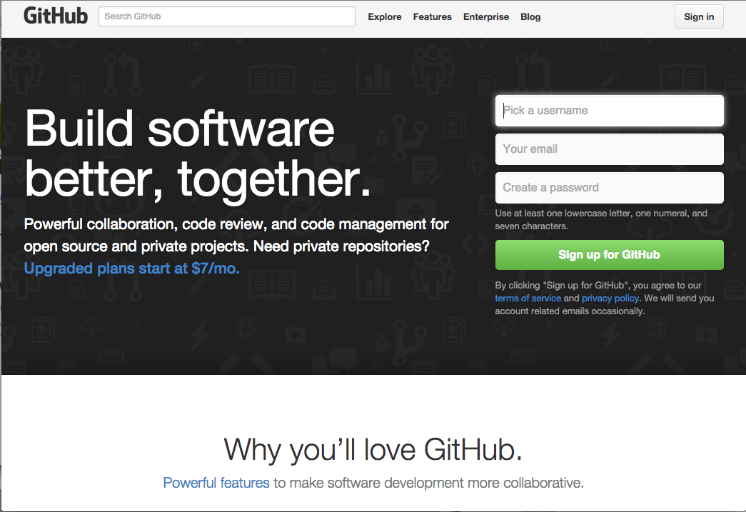
GitHub for Version Control
In this course we will be using GitHub for Version Control
This will count towards your final mark in each assignment.

Slide 5
What is Version Control?
Revision control, also known as version control and source control (and an aspect of software configuration management), is the management of changes to documents, computer programs, large web sites, and other collections of information.
Changes are usually identified by a number or letter code, termed the "revision number", "revision level", or simply "revision". For example, an initial set of files is "revision 1".
When the first change is made, the resulting set is "revision 2", and so on.
Each revision is associated with a timestamp and the person making the change.
Revisions can be compared, restored, and with some types of files, merged.

Slide 6

What is Git?
Git is a distributed revision control and source code management (SCM) system with an emphasis on speed, data integrity, and support for distributed, non-linear workflows.
Git was initially designed and developed by Linus Torvalds for Linux kernel development in 2005, and has since become the most widely adopted version control system for software development.
As with most other distributed revision control systems every Git working directory is a full-fledged repository with complete history and full version-tracking capabilities, independent of network access or a central server.

Slide 7

What is GitHub?
GitHub is a Git repository web-based hosting service which offers all of the distributed revision control and source code management (SCM) functionality of Git as well as adding many of its own features.
Unlike Git, which is strictly a command-line tool, GitHub provides a web-based graphical interface and desktop as well as mobile integration.

Slide 8
3 Good Reasons to use GitHub
Here are some great reasons to push projects to GitHub:
Version Control — Everything on GitHub is stored in the Git version control system. Version control allows you to experiment and make mistakes in code without messing up your final product.
Keep your code in one place — Whether you work on multiple computers or just want to get some old projects off your computer, GitHub is the perfect place to store your projects online.
Collaboration — Once your code is on GitHub, you can invite others to work on your code with you. Send them a link to help you debug a problem.

Slide 9
Installing the GitHub Client

Slide 10
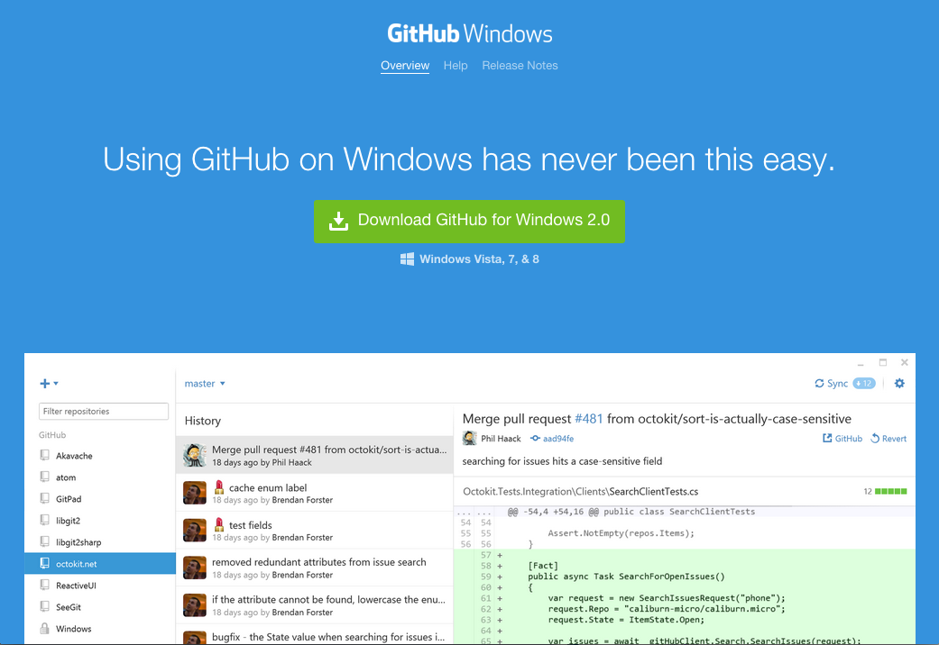
Download GitHub Client (Windows)
For Windows machines go to: http://windows.github.com/

Slide 11
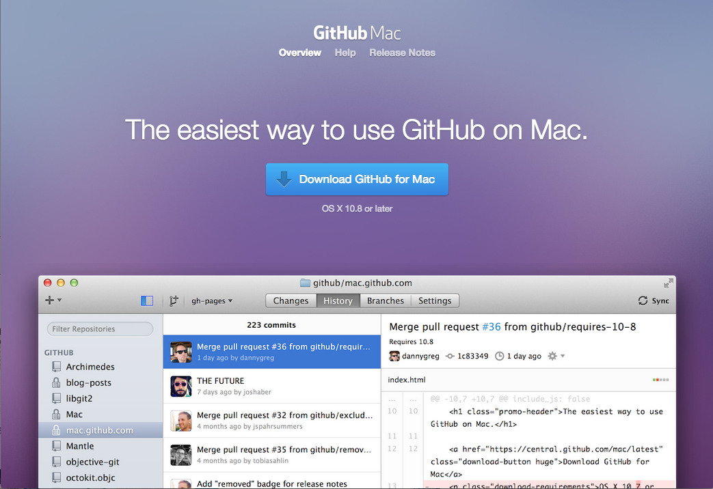
Download GitHub Client (Mac)
For MAC go to: http://mac.github.com/

Slide 12
Get a GitHub Account

Slide 13
Create a GitHub Account
Go to http://www.github.com
Create an account

Slide 14
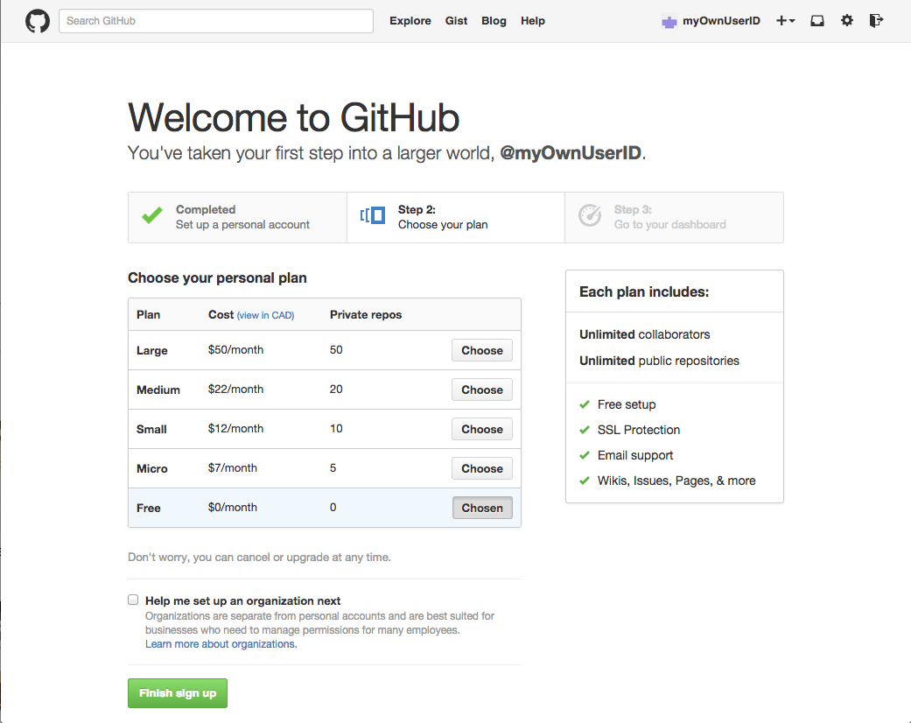
Choose your Plan
Free Plan is default – but not private repos
Click Finish sign up to continue

Slide 15
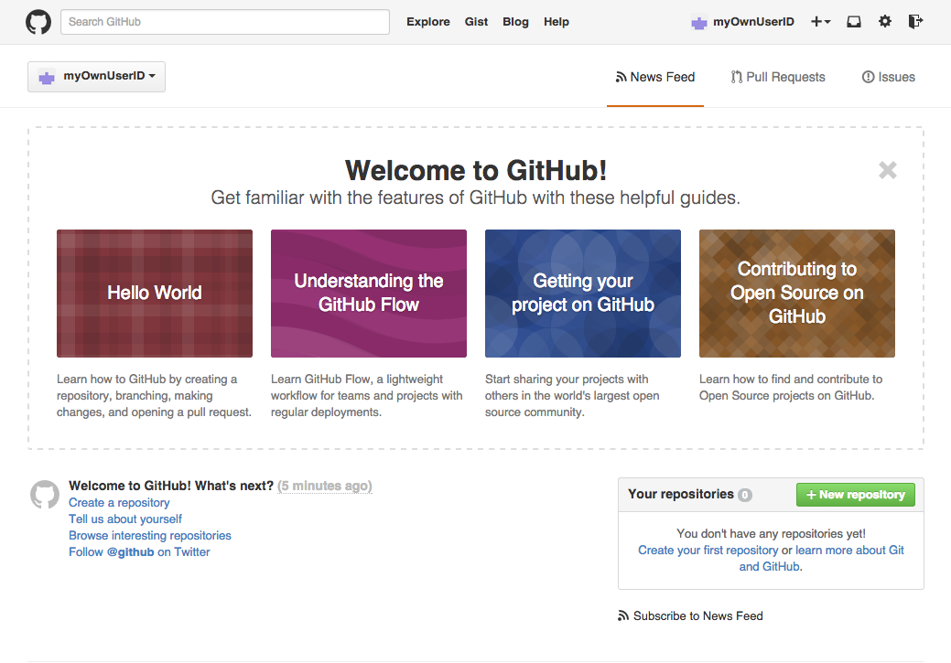
Welcome to GitHub!

Slide 16
Create a Repository

Slide 17

Create a Repository
A repository is the basic unit of GitHub, most commonly a single project.
Repositories can contain folders and files, including images – anything your project needs.
To create a new repository:
Click the icon next to your username, top-right.

Slide 18
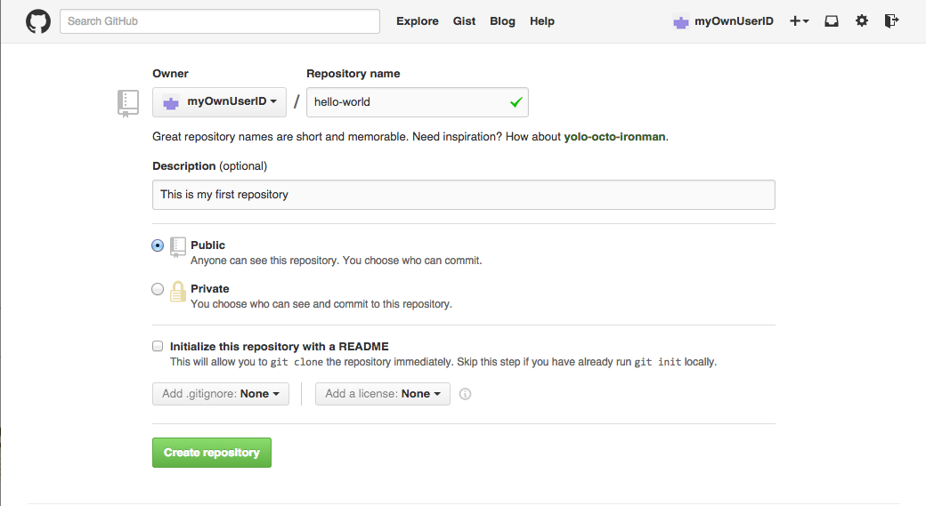
Create a Repository (continued)
Name your repository (example: hello-world).
Write a short description.
Click Create repository. Boom, repository!

Slide 19
Your First Commit

Slide 20
Make a Commit
On GitHub, saved changes are called commits. A bunch of commits can read like the history of your project.
Each commit has an associated commit message, which is a description explaining why a particular change was made.
Thanks to these messages, you and others can read through commits and understand what you’ve done and why.

